Slide 1
Forging new generations of engineers

Slide 2
Design Process Overview

Slide 3
What is Design?
The word “design” is often used as a generic term that refers to anything that was made by a conscious human effort.
Design is also a process that is used to systematically solve problems.
Notes:
Talk to students about how they use a sense of design every day. The process for getting ready for school is a good example.

Slide 4
What is a Design Process?
A design process is a systematic problem-solving strategy, with criteria and constraints, used to develop many possible solutions to solve or satisfy human needs or wants and to narrow down the possible solutions to one final choice.
– ITEA Standards for Technological Literacy
Notes:
Tell students: “This a primary focus of this course. You will learn what a design process is and apply it to several activities projects and problems”.

Slide 5
Design Process
There are several design processes used in the different technical fields. The following are examples.
Notes:
Tell students: “There are several examples used throughout the technical field.

Slide 6
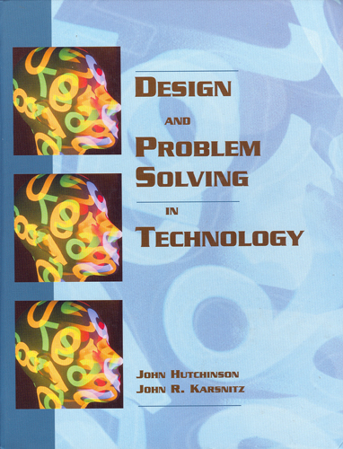
Example Design Process
Identifying problems and opportunities
Framing a design brief
Investigation and research
Generating alternative solutions
Choosing a solution
Developmental work
Modeling and prototyping
Testing and evaluating
Redesigning and improving
– Design and Problem Solving in Technology

Slide 7
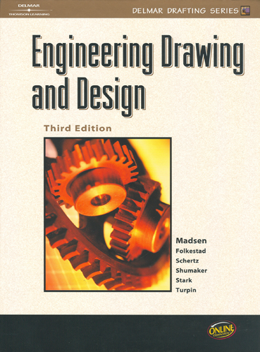
Example Design Process
Identify the need
Define the criteria
Explore/research/investigate
Generate alternate solutions
Choose a solution
Develop the solution
Model/prototype
Test and evaluate
Redesign and improve
– Engineering Drawing and Design (3rd edition)

Slide 8
The Adopted Design Process for PLTW courses
The following is the design process used for this course.
Notes:
Tell students: “There are sevral examples used throughout the technical field.

Slide 9
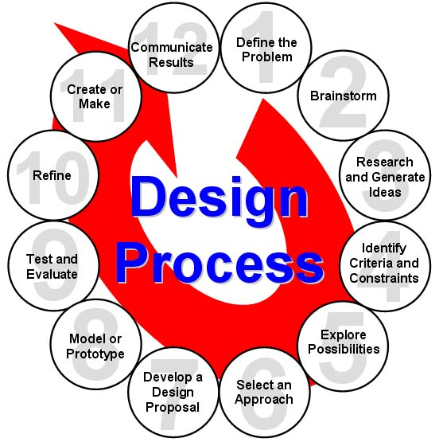
Example Design Process
Define a Problem
Brainstorm
Research and Generate Ideas
Identify Criteria and Specify Constraints
Explore Possibilities
Select an Approach
Develop a Design Proposal
Make a Model or Prototype
Test and Evaluate the Design using Specifications
Refine the Design
Create or Make Solution
Communicate Processes and Results
– ITEA Standards for Technological Literacy
Notes:
There are many design processes that guide professionals in developing solutions to problems. The example that you see here is the design process that we will use for this course and the rest of the Project Lead The Way, Inc. courses you will take.

Slide 10
1. Define a Problem
Receive a problem to solve from the client.
Gather information.
Be inspired through media exposure of a current problem and take action.
Notes:
Site examples from the Coffee Cup, Product Evolution, and Gossamer Condor Activities.

Slide 11
2. Brainstorm
A group problem-solving process in which each person in the group presents ideas in an open forum.
Generate and record ideas.
Keep the mind alert through rapidly paced sessions.
Develop preliminary ideas.
Notes:
Site examples from the Coffee Cup, Product Evolution, and Gossamer Condor Activities.

Slide 12
3. Research and Generate Ideas
Conduct interviews with those affected by the problem.
Research solutions that may already exist; identify shortcomings and reasons why they aren’t appropriate to a given situation.
Compile ideas and report findings to the team.
Notes:
Site examples from the Coffee Cup, Product Evolution, and Gossamer Condor Activities.

Slide 13
4. Identify Criteria and Specify Constraints
Identify what the solution should do and the degree to which the solution will be pursued.
Identify constraints (i.e., budget and time are typical considerations).
Draft the Design Brief.
Notes:
Site examples from the Coffee Cup, Product Evolution, and Gossamer Condor Activities.

Slide 14
5. Explore Possibilities
Consider further development of brainstorming ideas with constraints and tradeoffs.
Explore alternative ideas based on further knowledge and technologies.
Notes:
Site examples from the Coffee Cup, Product Evolution, and Gossamer Condor Activities.

Slide 15
6. Select an Approach
Review brainstormed information and answer any lingering questions.
Narrow ideas down through a voting process, or by use of a decision matrix.
Decide on final idea, usually through group consensus.
Notes:
Site examples from the Coffee Cup, Product Evolution, and Gossamer Condor Activities.

Slide 16
7. Develop a Design Proposal
Explore the idea in greater detail with annotated sketches.
Make critical decisions such as material types and manufacturing methods.
Generate through computer models detailed sketches to further refine the idea.
Produce working drawings so the idea can be built.
Notes:
Site examples from the Coffee Cup, Product Evolution, and Gossamer Condor Activities.

Slide 17
8. Make a Model or Prototype
Make models to help communicate the idea, and study aspects such as shape, form, fit, or texture.
Construct a prototype from the working drawings, so the solution can be tested.
Notes:
Site examples from the Coffee Cup, Product Evolution, and Gossamer Condor Activities.

Slide 18
9. Test and Evaluate the Design using Specifications
Design experiments and test the prototype in controlled and working environments.
Gather performance data; analyze and check results against established criteria.
Conduct a formal critique to flesh out areas of concerns, identify shortcomings, and establish any need for redesign work.
Notes:
Site examples from the Coffee Cup, Product Evolution, and Gossamer Condor Activities.

Slide 19
10. Refine the Design
Make design changes; modify or rebuild the prototype.
Make refinements until accuracy and repeatability of the prototype’s performance results are consistent.
Update documentation to reflect changes.
Receive user’s critique to provide outside perspective to help determine if established criteria have been met.
Notes:
Site examples from the Coffee Cup, Product Evolution, and Gossamer Condor Activities.

Slide 20
11. Create or Make Solution
Determine custom/mass production.
Consider packaging.
Notes:
Mention the difference between Custom and MassProduction
Site examples from the Coffee Cup, Product Evolution, and Gossamer Condor Activities.

Slide 21
12. Communicate Processes and Results
Communicate the designer’s final solution through media such as PowerPoint, poster session, technical report.
Market the Product.
Distribute.
Notes:
Site examples from the Coffee Cup, Product Evolution, and Gossamer Condor Activities.

