Slide 2
Basic Assembly Constraints
Assembly Constraints
Define how parts relate to each other.

Slide 3
Basic Assembly Constraints
Degrees of Freedom
6 Degrees:
3 Rotational Around X, Y, Z axes
3 Translational Around X, Y,
Z axes

Slide 4
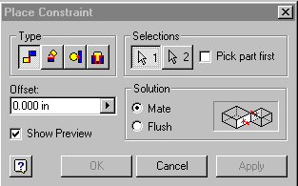
Basic Assembly Constraints
4 Basic Constraints
Mate/Flush
Angle
Insert
Tangent

Slide 5
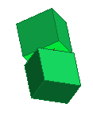
Basic Assembly Constraints
Mate:
Constrains 2 faces, edges, points or work features together
Normal vectors point toward each other

Slide 6
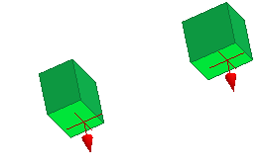
Basic Assembly Constraints
Flush:
Constrains 2 faces, edges, points or work features together
Geometry side-by-side
Normal Vectors pointing in same direction

Slide 7
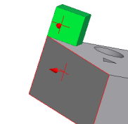
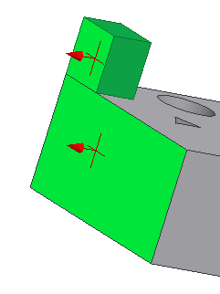
Basic Assembly Constraints
Angle:
Constrains 2 faces or edges at an angle to one another

Slide 8
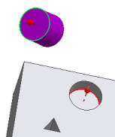
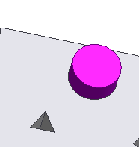
Basic Assembly Constraints
Insert:
Constrains a cylinder flush into a hole

Slide 9
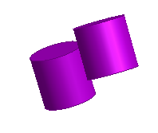
Basic Assembly Constraints
Tangent:
Constrains a curved surface to a plane or another curved surface

